Slide 1
Chapter 9
Relational Database Design by ER- and EER-to-Relational Mapping

Slide 2
Chapter 9 Outline
Relational Database Design Using ER-to-Relational Mapping
Mapping EER Model Constructs to Relations

Slide 3
Relational Database
Design by ER- and EER-to-Relational Mapping
Design a relational database schema
  Based on a conceptual schema design
Seven-step algorithm to convert the basic ER model constructs into relations
Additional steps for EER model

Slide 4
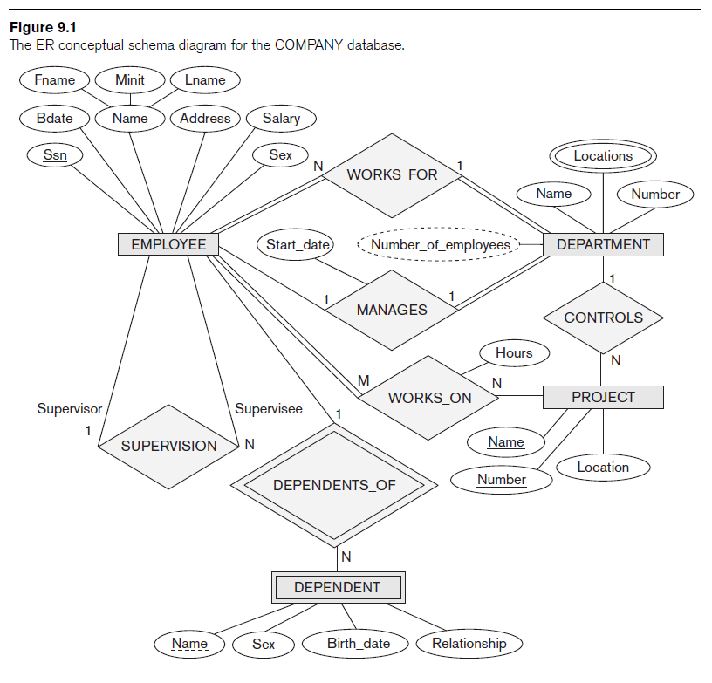
Relational Database Design Using ER-to-Relational Mapping

Slide 5
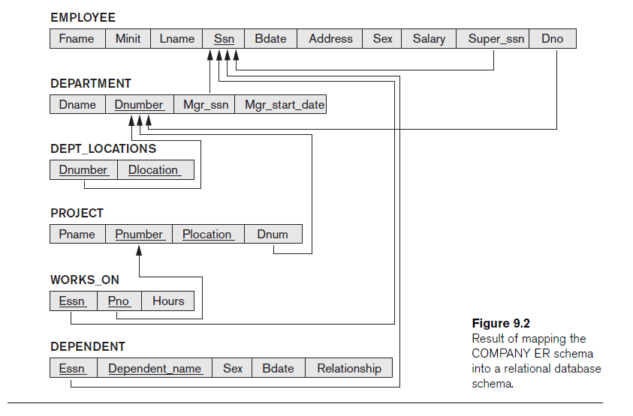

Slide 6
ER-to-Relational Mapping Algorithm
COMPANY database example
  Assume that the mapping will create tables with simple single-valued attributes
Step 1: Mapping of Regular Entity Types
  For each regular entity type, create a relation R that includes all the simple attributes of E
  Called entity relations
    Each tuple represents an entity instance

Slide 7
ER-to-Relational Mapping Algorithm (cont’d.)
Step 2: Mapping of Weak Entity Types
  For each weak entity type, create a relation R and include all simple attributes of the entity type as attributes of R
  Include primary key attribute of owner as foreign key attributes of R

Slide 8
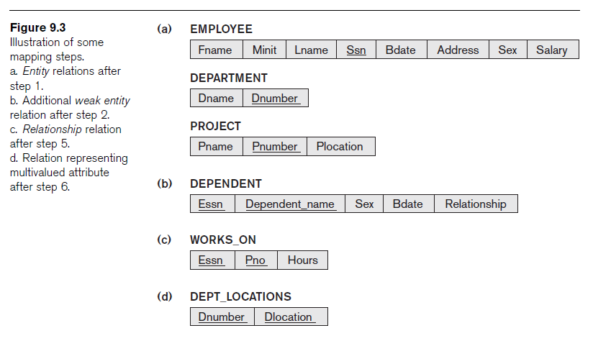
ER-to-Relational Mapping Algorithm (cont’d.)
Notes:
a) Regular Entity Types : EMPLOYEE, DEPARTMENT, PROJECT (step 1)
b) Weak Entity Type : DEPENDENT (step 2)
c) Relationship relation (step 5)
d) Relation representing multivalued attribute (step 6)

Slide 9
ER-to-Relational Mapping Algorithm (cont’d.)
Step 3: Mapping of Binary 1:1 Relationship Types
  For each binary 1:1 relationship type
    Identify relations that correspond to entity types participating in R
  Possible approaches:
    Foreign key approach
    Merged relationship approach
    Cross-reference or relationship relation approach
Notes:
Foreign key approach : We map the 1:1 relationship type MANAGES from Figure 9.1 by choosing the participating entity type DEPARTMENT to serve in the role of S because its participation in the MANAGES relationship type is total (every department has a manager).
Merged relationship approach : An alternative mapping of a 1:1 relationship type is to merge the two entity types and the relationship into a single relation. This is possible when both participations are total, as this would indicate that the two tables will have the exact same number of tuples at all times.
Cross-reference or relationship relation approach : The third option is to set up a third relation R for the purpose of cross-referencing the primary keys of the two relations S and T representing the entity types.
The relation R will include the primary key attributes of S and T as foreign keys to S and T. The primary key of R will be one of the two foreign keys, and the other foreign key will be a unique key of R .

Slide 10
ER-to-Relational Mapping Algorithm (cont’d.)
Step 4: Mapping of Binary 1:N Relationship Types
  For each regular binary 1:N relationship type
    Identify relation that represents participating entity type at N-side of relationship type
    Include primary key of other entity type as foreign key in S
    Include simple attributes of 1:N relationship type as attributes of S
Notes:
In our example, we now map the 1:N relationship types WORKS_FOR, CONTROLS, and SUPERVISION from Figure 9.1. For WORKS_FOR we include the primary key Dnumber of the DEPARTMENT relation as foreign key in the EMPLOYEE relation and call it Dno. For SUPERVISION we include the primary key of the EMPLOYEE relation as foreign key in the EMPLOYEE relation itself—because the relationship is recur- sive—and call it Super_ssn. The CONTROLS relationship is mapped to the foreign key attribute Dnum of PROJECT, which references the primary key Dnumber of the DEPARTMENT relation

Slide 11
ER-to-Relational Mapping Algorithm (cont’d.)
  Alternative approach
    Use the relationship relation (cross-reference) option as in the third option for binary 1:1 relationships
Notes:
Create another relation -

Slide 12
ER-to-Relational Mapping Algorithm (cont’d.)
Step 5: Mapping of Binary M:N Relationship Types
  For each binary M:N relationship type
    Create a new relation S
    Include primary key of participating entity types as foreign key attributes in S
    Include any simple attributes of M:N relationship type
Notes:
Their combination will form the primary key of S
In our example, we map the M:N relationship type WORKS_ON from Figure 9.1 by creating the relation WORKS_ON in Figure 9.2. We include the primary keys of the PROJECT and EMPLOYEE relations as foreign keys in WORKS_ON and rename them Pno and Essn, respectively. We also include an attribute Hours in WORKS_ON to represent the Hours attribute of the relationship type. The primary key of the WORKS_ON relation is the combination of the foreign key attributes {Essn, Pno}.

Slide 13
ER-to-Relational Mapping Algorithm (cont’d.)
Step 6: Mapping of Multivalued Attributes
  For each multivalued attribute
    Create a new relation
    Primary key of R is the combination of A and K
    If the multivalued attribute is composite, include its simple components
Notes:
In our example, we create a relation DEPT_LOCATIONS (see Figure 9.3(d)). The attribute Dlocation represents the multivalued attribute LOCATIONS of DEPARTMENT, while Dnumber—as foreign key—represents the primary key of the DEPARTMENT relation. The primary key of DEPT_LOCATIONS is the combination of {Dnumber, Dlocation}. A separate tuple will exist in DEPT_LOCATIONS for each location that a department has.

Slide 14
ER-to-Relational Mapping Algorithm (cont’d.)
Step 7: Mapping of N-ary Relationship Types
  For each n-ary relationship type R
    Create a new relation S to represent R
    Include primary keys of participating entity types as foreign keys
    Include any simple attributes as attributes
Notes:
For each n-ary relationship type R, where n > 2, create a new relation S to represent R. Include as foreign key attributes in S the primary keys of the relations that represent the participating entity types.
For example, consider the relationship type SUPPLY in Figure 7.17. This can be mapped to the relation SUPPLY shown in Figure 9.4, whose primary key is the combination of the three foreign keys {Sname, Part_no, Proj_name}.

Slide 15
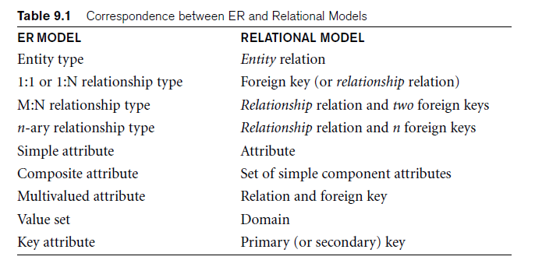
Discussion and Summary of Mapping for ER Model Constructs

Slide 16
Discussion and Summary of Mapping for ER Model Constructs (cont’d.)
In a relational schema relationship, types are not represented explicitly
  Represented by having two attributes A and B: one a primary key and the other a foreign key

Slide 17
Mapping EER Model Constructs to Relations
Extending ER-to-relational mapping algorithm

Slide 18
Mapping of Specialization or Generalization
Step 8: Options for Mapping Specialization or Generalization (see pages 294-295)
  Option 8A: Multiple relations—superclass and subclasses
    For any specialization (total or partial, disjoint or overlapping)
  Option 8B: Multiple relations—subclass relations only
    Subclasses are total
    Specialization has disjointedness constraint

Slide 19
Mapping of Specialization or Generalization (cont’d.)
  Option 8C: Single relation with one type attribute
    Type or discriminating attribute indicates subclass of tuple
    Subclasses are disjoint
      Potential for generating many NULL values if many specific attributes exist in the subclasses
  Option 8D: Single relation with multiple type attributes
    Subclasses are overlapping
    Will also work for a disjoint specialization

Slide 20
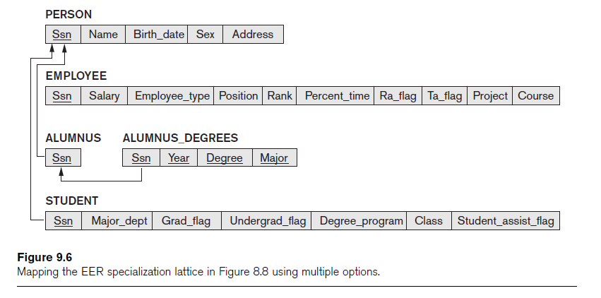
Mapping of Shared Subclasses (Multiple Inheritance)
Apply any of the options discussed in step 8 to a shared subclass

Slide 21
Mapping of Categories (Union Types)
Step 9: Mapping of Union Types (Categories)
  Defining super classes have different keys
  Specify a new key attribute
    Surrogate key

Slide 22
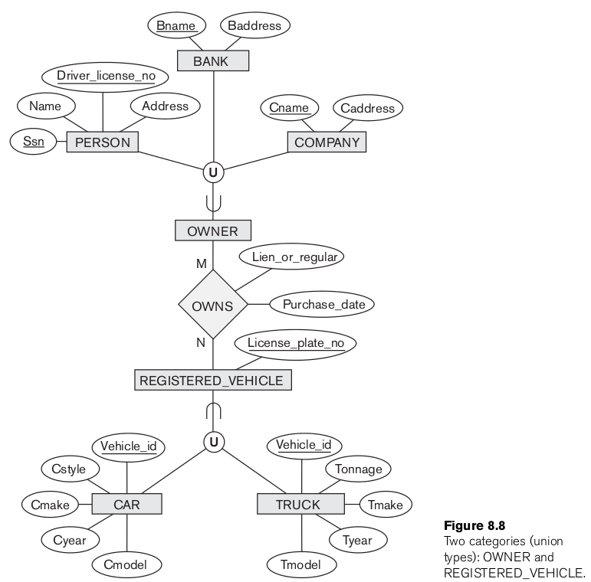
Mapping of Categories (Union Types)

Slide 23
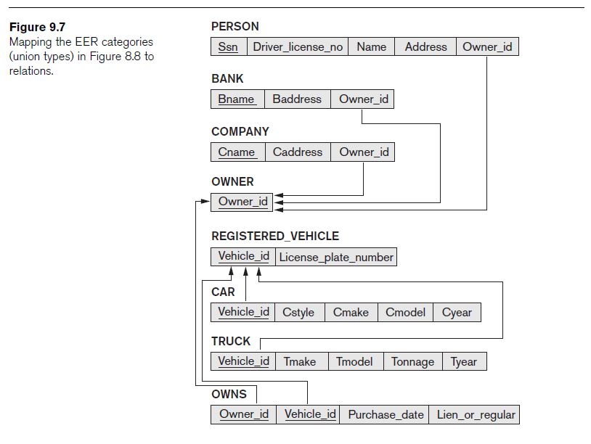

Slide 24
Summary
Map conceptual schema design in the ER model to a relational database schema
  Algorithm for ER-to-relational mapping
  Illustrated by examples from the COMPANY database
Include additional steps in the algorithm for mapping constructs from EER model into relational model

